Slide 1

Cardiovascular
Maria Noori

Slide 2
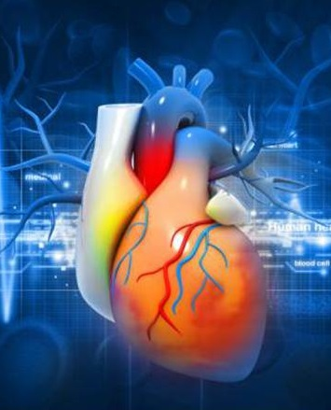
Risk Factors for Cardiovascular Heart Disease
This dataset can be used to explore the risk factors of cardiovascular disease in adults. This dataset contains detailed information on the risk factors for cardiovascular disease. It includes information on age, gender, height, weight, blood pressure values, cholesterol levels, glucose levels, smoking habits and alcohol consumption of over 70 thousand individuals.
https://www.kaggle.com/datasets/thedevastator/exploring-risk-factors-for-cardiovascular-diseas

Slide 3
Variables of dataset
Age: Age of participant (integer)
Gender: Gender of participant (male/female).
Height: Height measured in centimeters (integer)
Weight: Weight measured in kilograms (integer)
Ap_hi: Systolic blood pressure reading taken from patient (integer)
Ap_lo: Diastolic blood pressure reading taken from patient (integer)
Cholesterol: Total cholesterol level read as mg/dl on a scale 0 - 5+ units( integer). Each unit denoting increase/decrease by 20 mg/dL respectively.
Gluc: Glucose level read as mmol/l on a scale 0 - 16+ units( integer). Each unit denoting increase Decrease by 1 mmol/L respectively.
Smoke: Whether person smokes or not(binary; 0= No , 1=Yes).
Alco: Whether person drinks alcohol or not(binary; 0=No ,1 =Yes ).
Active: whether person physically active or not( Binary ;0 =No,1 = Yes ).
Cardio: whether person suffers from cardiovascular diseases or not(Binary ;0=No , 1=Yes )

Slide 4
Data preparation Preprocessing/ Clean Up
 | index | id | age | gender | height | weight | ap_hi | ap_lo | cholesterol | gluc | smoke | alco | active | cardio
0 | 0 | 0 | 18393 | 2 | 168 | 62.0 | 110 | 80 | 1 | 1 | 0 | 0 | 1 | 0
1 | 1 | 1 | 20228 | 1 | 156 | 85.0 | 140 | 90 | 3 | 1 | 0 | 0 | 1 | 1
2 | 2 | 2 | 18857 | 1 | 165 | 64.0 | 130 | 70 | 3 | 1 | 0 | 0 | 0 | 1
3 | 3 | 3 | 17623 | 2 | 169 | 82.0 | 150 | 100 | 1 | 1 | 0 | 0 | 1 | 1
4 | 4 | 4 | 17474 | 1 | 156 | 56.0 | 100 | 60 | 1 | 1 | 0 | 0 | 0 | 0
Remove index and id columns
Convert age variable from days to years
There were no duplicates or missing data
Gender: 1 represents women, 2 represents men
(Average height of women is less than men)
70% train data, 30% test data

Slide 5
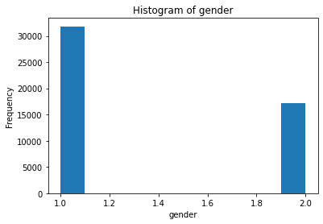
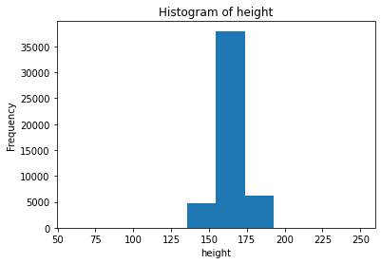
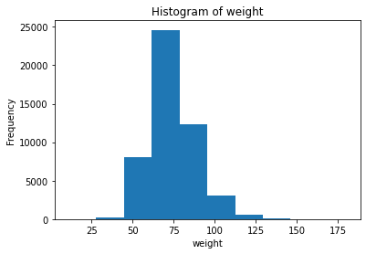
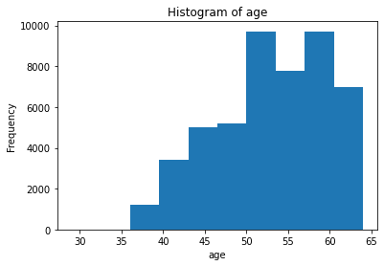
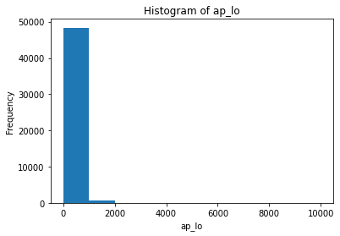
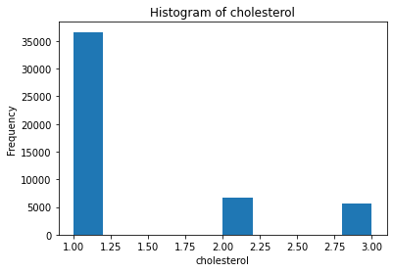
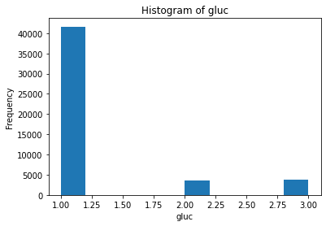
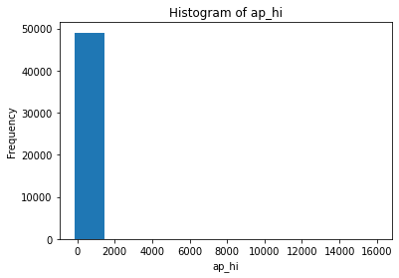
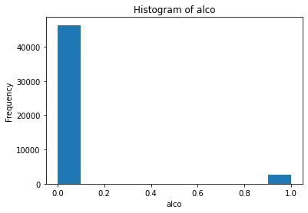
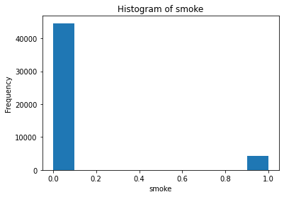
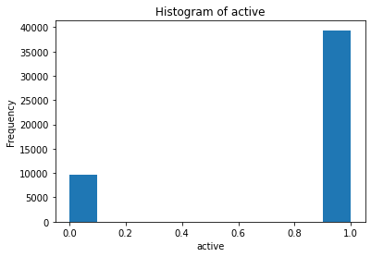
Visualization
Notes:
Histogram using X_train Data

Slide 6
 | id | age | gender | height | weight | ap_hi | ap_lo | cholesterol | gluc | smoke | alco | active | cardio
count | 70000.000000 | 70000.000000 | 70000.000000 | 70000.000000 | 70000.000000 | 70000.000000 | 70000.000000 | 70000.000000 | 70000.000000 | 70000.000000 | 70000.000000 | 70000.000000 | 70000.000000
mean | 49972.419900 | 52.840671 | 1.349571 | 164.359229 | 74.205690 | 128.817286 | 96.630414 | 1.366871 | 1.226457 | 0.088129 | 0.053771 | 0.803729 | 0.499700
std | 28851.302323 | 6.766774 | 0.476838 | 8.210126 | 14.395757 | 154.011419 | 188.472530 | 0.680250 | 0.572270 | 0.283484 | 0.225568 | 0.397179 | 0.500003
min | 0.000000 | 29.000000 | 1.000000 | 55.000000 | 10.000000 | -150.000000 | -70.000000 | 1.000000 | 1.000000 | 0.000000 | 0.000000 | 0.000000 | 0.000000
25% | 25006.750000 | 48.000000 | 1.000000 | 159.000000 | 65.000000 | 120.000000 | 80.000000 | 1.000000 | 1.000000 | 0.000000 | 0.000000 | 1.000000 | 0.000000
50% | 50001.500000 | 53.000000 | 1.000000 | 165.000000 | 72.000000 | 120.000000 | 80.000000 | 1.000000 | 1.000000 | 0.000000 | 0.000000 | 1.000000 | 0.000000
75% | 74889.250000 | 58.000000 | 2.000000 | 170.000000 | 82.000000 | 140.000000 | 90.000000 | 2.000000 | 1.000000 | 0.000000 | 0.000000 | 1.000000 | 1.000000
max | 99999.000000 | 64.000000 | 2.000000 | 250.000000 | 200.000000 | 16020.000000 | 11000.000000 | 3.000000 | 3.000000 | 1.000000 | 1.000000 | 1.000000 | 1.000000
Notes:
Summary Statistics

Slide 7
 | age | gender | height | weight | ap_hi | ap_lo | cholesterol | gluc | smoke | alco | active
age | 1.000000 | -0.023287 | -0.082496 | 0.052583 | 0.017949 | 0.015020 | 0.152419 | 0.098641 | -0.051759 | -0.029750 | -0.011201
gender | -0.023287 | 1.000000 | 0.500974 | 0.156379 | 0.011955 | 0.014116 | -0.036353 | -0.020237 | 0.338167 | 0.170480 | 0.004414
height | -0.082496 | 0.500974 | 1.000000 | 0.292150 | 0.007936 | 0.004798 | -0.050900 | -0.022499 | 0.189647 | 0.095778 | -0.004148
weight | 0.052583 | 0.156379 | 0.292150 | 1.000000 | 0.029315 | 0.041651 | 0.143280 | 0.109920 | 0.069926 | 0.067322 | -0.013892
ap_hi | 0.017949 | 0.011955 | 0.007936 | 0.029315 | 1.000000 | 0.017944 | 0.022008 | 0.006949 | -0.000631 | 0.002930 | 0.000569
ap_lo | 0.015020 | 0.014116 | 0.004798 | 0.041651 | 0.017944 | 1.000000 | 0.023599 | 0.009615 | 0.001209 | 0.010689 | 0.002604
cholesterol | 0.152419 | -0.036353 | -0.050900 | 0.143280 | 0.022008 | 0.023599 | 1.000000 | 0.452703 | 0.009934 | 0.032538 | 0.010057
gluc | 0.098641 | -0.020237 | -0.022499 | 0.109920 | 0.006949 | 0.009615 | 0.452703 | 1.000000 | -0.004967 | 0.008838 | -0.006702
smoke | -0.051759 | 0.338167 | 0.189647 | 0.069926 | -0.000631 | 0.001209 | 0.009934 | -0.004967 | 1.000000 | 0.346808 | 0.027505
alco | -0.029750 | 0.170480 | 0.095778 | 0.067322 | 0.002930 | 0.010689 | 0.032538 | 0.008838 | 0.346808 | 1.000000 | 0.025340
active | -0.011201 | 0.004414 | -0.004148 | -0.013892 | 0.000569 | 0.002604 | 0.010057 | -0.006702 | 0.027505 | 0.025340 | 1.000000
Notes:
Correlation Matrix

Slide 8
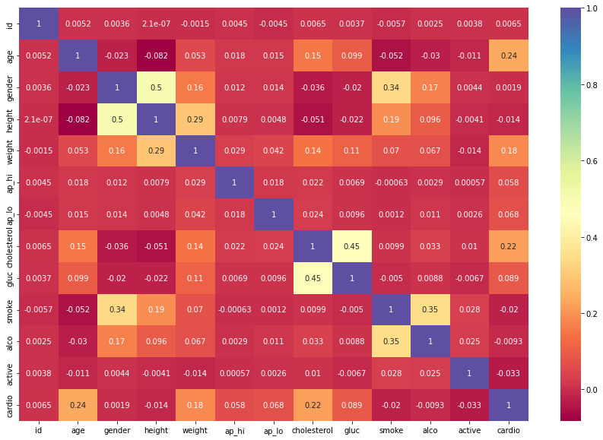
Heatmap

Slide 9
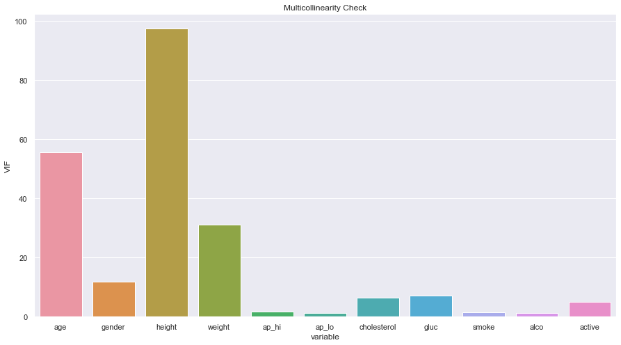

Slide 10
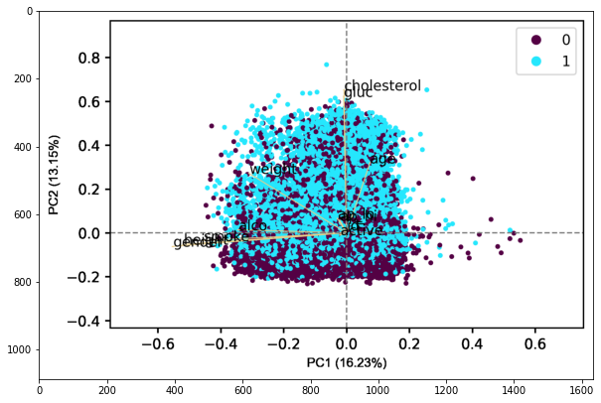
PCA (Logistic Regression)
Accuracy: 0.824 (0.034)

Slide 11
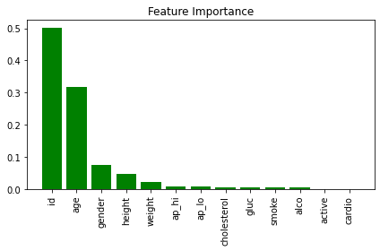
RF train accuracy: 1.000
RF test accuracy: 0.722

Slide 12
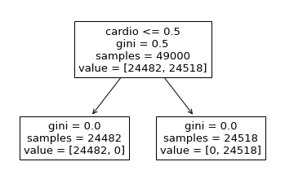
Decision Tree
Train data accuracy: 1.0
Test data accuracy: 0.9925238095238095

Slide 13

Dimensionality Reduction Techniques

Slide 14
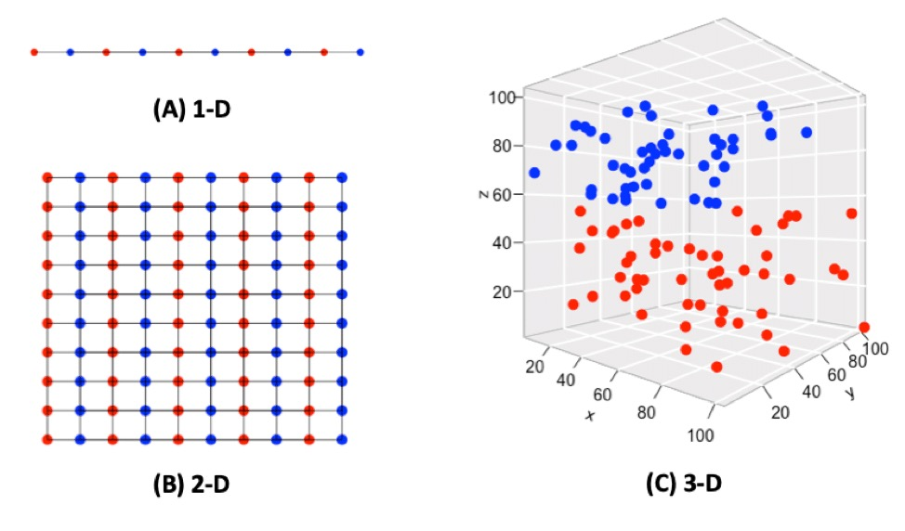
The Curse of Dimensionality
The curse of dimensionality is a phenomenon that arises when you work (analyze and visualize) with data in high-dimensional spaces that do not exist in low-dimensional spaces.

Slide 15
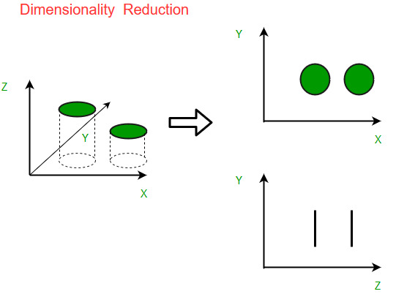
Dimensionality Reduction
Dimensionality reduction refers to the technique of reducing the dimension of a data feature set.
Dimensionality reduction techniques can be categorized into two broad categories:
Feature Selection (three strategies)
Filter strategy
Wrapper strategy
Embedded strategy
Feature Extraction
feature projection (conversion from high to lower dimension)

Slide 16
Dimension Reduction Methods
Principal Component Analysis (PCA)
Non-negative matrix factorization (NMF)
Linear discriminant analysis (LDA)
Generalized discriminant analysis (GDA)
Missing Values Ratio
Low Variance Filter
High Correlation Filter
Backward Feature Elimination
Forward Feature Construction
Random Forests

Slide 17
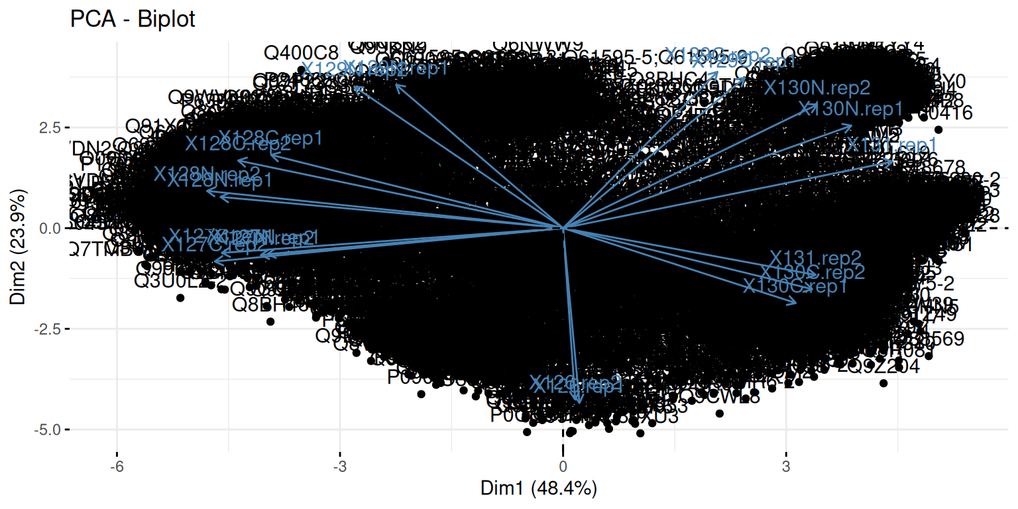
Why is it important to use dimensional reduction techniques:
It is hard to visualize the training dataset and work on it.
Many variables are correlated.
When training a ML model in a large dataset, it will result in an overfitted model that fails to perform well on real data.

Slide 18
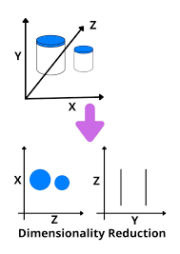
Benefits:
It eliminates noise and redundant features.
It helps improve the model’s accuracy and performance.
It facilitates the usage of algorithms that are unfit for more substantial dimensions.
It reduces the amount of storage space required (less data needs lesser storage space).
It compresses the data, which reduces the computation time and facilitates faster training of the data.

Slide 19
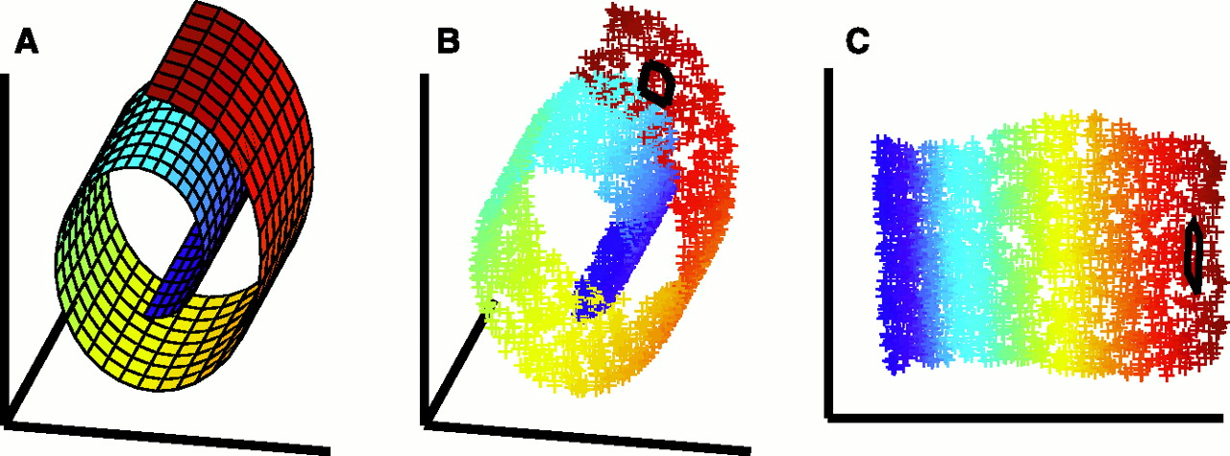
Advantages
Helps in data compression
Reduces storage space and computation time
Helps remove redundant features, if any
Takes care of multicollinearity that improves the model performance
Helps to observe patterns more clearly

Slide 20
Disadvantages
May lead to some amount of data loss
PCA fails in cases where mean and covariance are not enough to define datasets.

Slide 21
Reference
https://www.upgrad.com/blog/top-dimensionality-reduction-techniques-for-machine-learning/
https://data-flair.training/blogs/dimensionality-reduction-tutorial/

